Slide 1
Infiltration and Inflow Control Massachusetts Regulatory Framework
Kevin Brander
Bureau of Water Resources
Scott Haynes, PE, BCEE
Paul Batman, PE

Slide 2
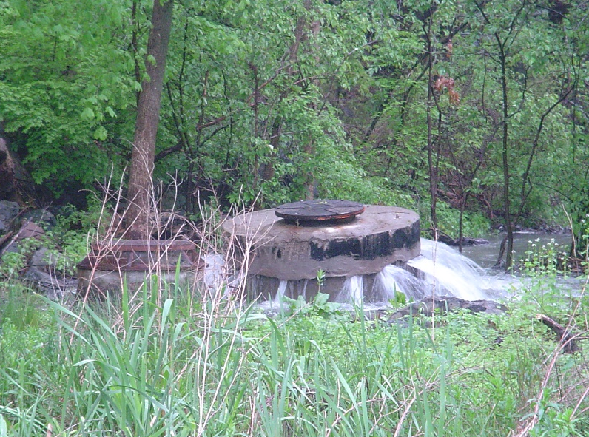
Overview
Sanitary Sewer Overflows
Public Health Problem!!
Sewer Authorities in MA
Must have program to
remove Infiltration/Inflow
MassDEP issued updated I/I Guidance in May 2017

Slide 3
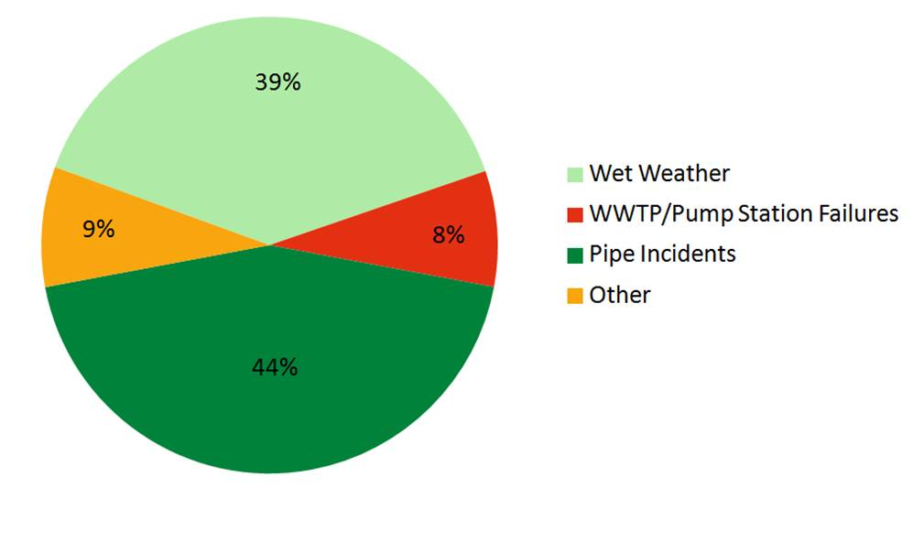
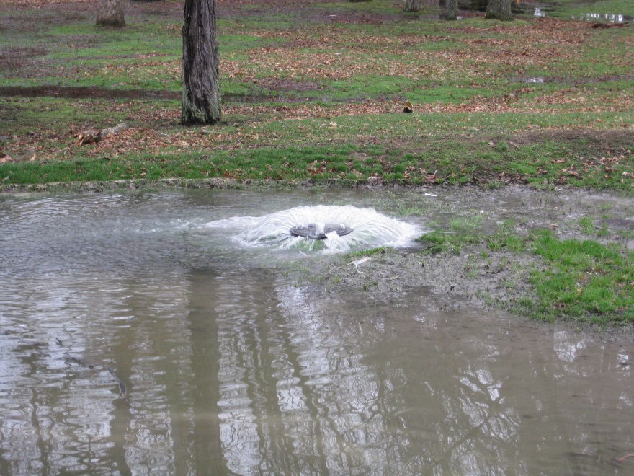
SSO Problems
Since 2006 in MA Northeast Region…
> 3,800 events in 70 communities

Slide 4
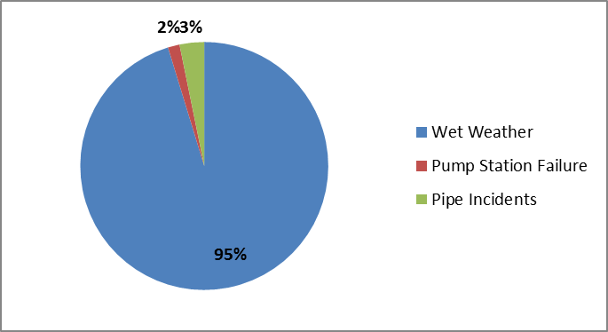
SSO Volumes
But……….looking at SSO volume by cause…
Over 650 million gallons in SSO!

Slide 5
SSO’s create Public Health Risks!!

Slide 6
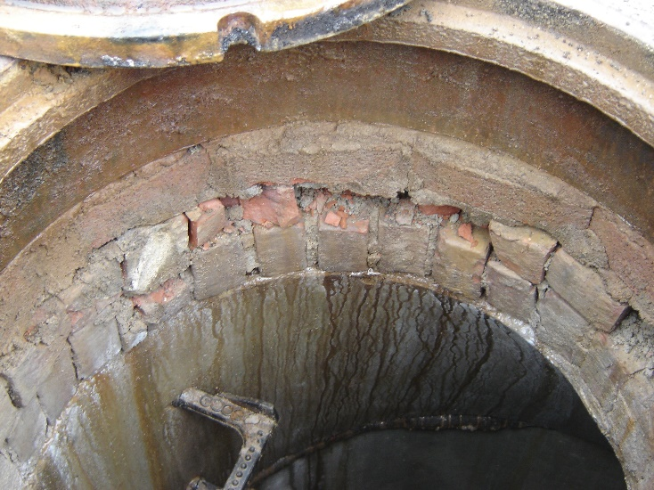
Infiltration
groundwater entering sewers, service laterals, or manholes through defects and joints in the system.

Slide 7
Inflow
Stormwater or surface waters entering the sewer system through drains, catch basins, roof leaders, manhole covers, and flows from sump pumps connected to the sewer.
Over 19,000 disconnected in Boston
So far!!

Slide 8
Regulatory Requirements
Regulatory Requirements 314 CMR 12.04(2):
All MA Sewer Authorities must develop and implement an ongoing I/I program:
Identify and eliminate “excessive” Inflow/Infiltration sources
Focus on inflow sources
Phased evaluation of sewer system consistent with MassDEP Guidance
I/I mitigation for new connections for CSO and tributary systems

Slide 9
Regulatory Requirements - Mitigation
For CSO/tributary systems:
4:1 I/I mitigation requirement for all
new connections > 15,000 gpd
Up to sewer authority to establish program, including:
Design flows
Direct removals or Fees
NepRWA Sewer Banking guidance at https://www.neponset.org/projects/publications/

Slide 10
Regulatory Requirements
By December 2017 submit I/I Analysis:
To address excessive I/I based on MassDEP’s Guidelines for Performing I/I Analyses and Sewer System Evaluation Surveys
Assess the risk for sanitary sewer overflows for the 5-year, 24 hour storm
Many municipalities well into implementation phase!

Slide 12
Infiltration and Inflow Program Guidance
Revised MassDEP I/I Guidance (1993 2017)
NEWEA Collection System Committee/Advisory Group
held meetings, conference calls
Notice for Public Comment in 8/24/2016 Environmental Monitor
Comments from municipal groups, consultants
Final Guidance issued May 2017
http://www.mass.gov/eea/agencies/massdep/water/wastewater/sewer-systems.html#5

Slide 13
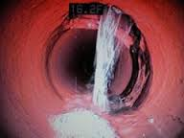
2017 Guidance – I/I Abatement Programs
Guidance establishes four step approach:
Infiltration and Inflow Analysis – by 12/31/2017
Sewer System Evaluation Survey
Sewer System Rehabilitation
Post-Construction Monitoring
Alternative approaches may
be proposed!

Slide 14
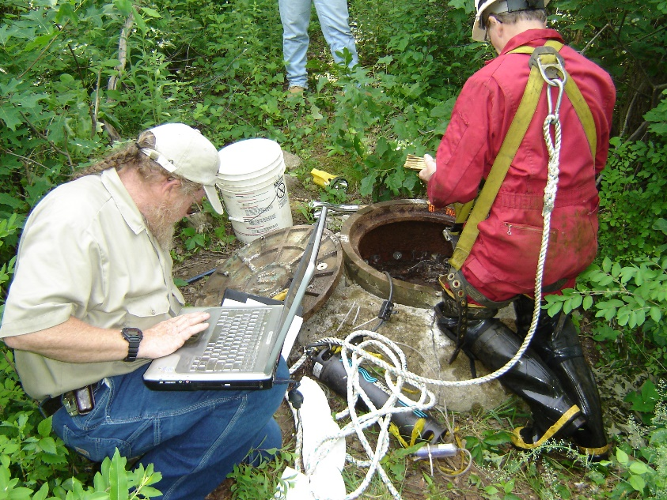
Elements of I/I Analysis
Inventory of Sewer System/GIS
Flow Monitoring (3/1 – 6/30)
Manhole inspections (10%)
GW monitoring
Rainfall Monitoring
(min 2 gauges, 1 per 3-4 mi²)
Flow Data Analysis:
Sanitary
Infiltration (peak and average)
Inflow (correlating to storm size)

Slide 15
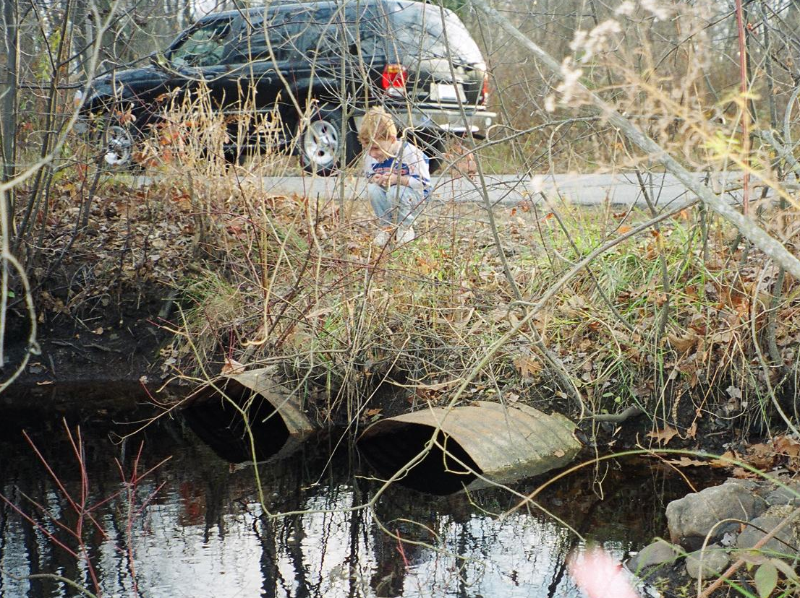
Elements of I/I Analysis SSO Analysis – 5 Year Storm
National Oceanic and Atmospheric Administration Atlas 14, Volume 10
5 Year 24-hour event:
4.61 inches of rain
Peak intensity of 0.73 in/hr
Wet Weather SSO event assessment
Review wet weather SSO event history vs. storm events

Slide 16
I/I Analysis Report
I/I Analysis Report Recommendations:
Develop Sewer System Evaluation Survey (SSES) Program based on flow monitoring findings ……
Infiltration: Prioritize subareas with highest infiltration for further investigation – initially those > 4,000 gpdim
Inflow: Further investigation of subareas comprising 80% of total inflow to system

Slide 17
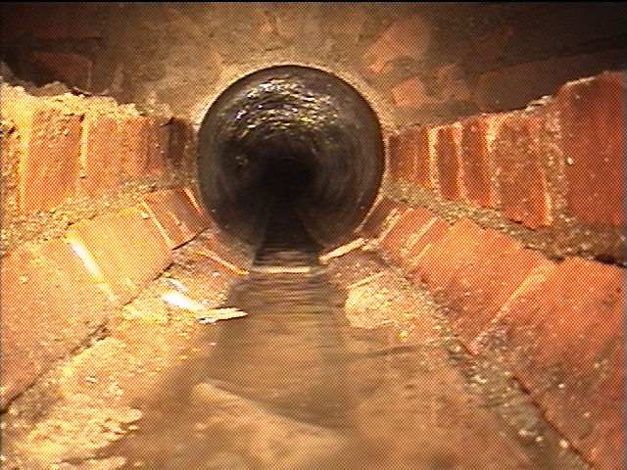
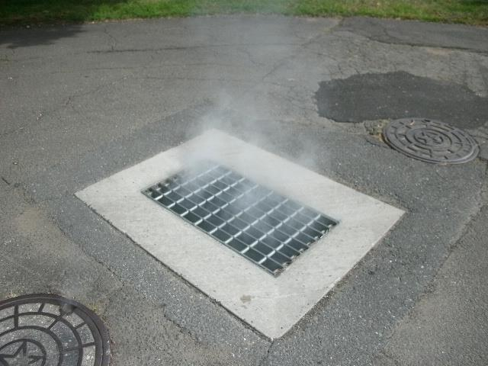
Sewer System Evaluation Survey
SSES: I/I investigations to identify Specific Sources
Infiltration: Flow isolation Inflow: Smoke testing, dye
CCTV, manhole inspections testing, property inspections
SSES targets removal of Excessive I/I

Slide 18
2016 Guidance – When is I/I Excessive?
“Excessive” I/I:
Contributes/causes SSO’s for events up to 5 year storm
Infiltration which can be cost-effectively removed from the sewer system
Public and private inflow sources, unless technically infeasible or cost-prohibitive

Slide 19
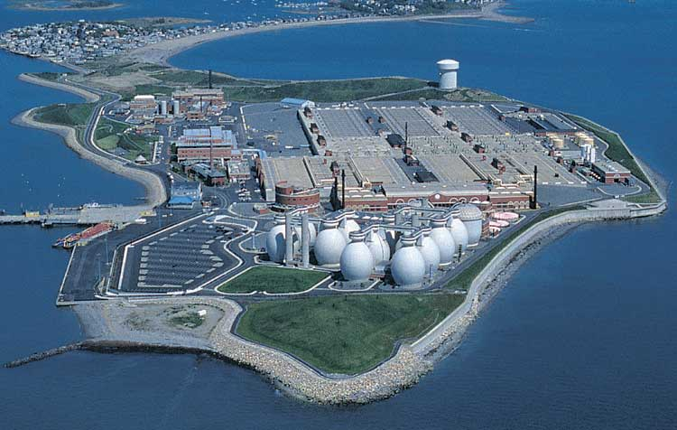
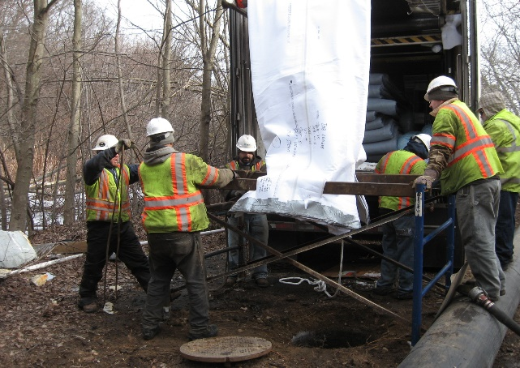
Sewer System Evaluation Survey
Cost-Effectiveness Evaluation (CEA):
Infiltration Sources: Evaluate costs to Transport/Treat infiltration vs. Removal Costs
>
Typical Fixes: pipe and MH lining, spot repairs, grouting
Inflow Sources: No CEA! Remove unless technically infeasible or cost-prohibitive

Slide 20
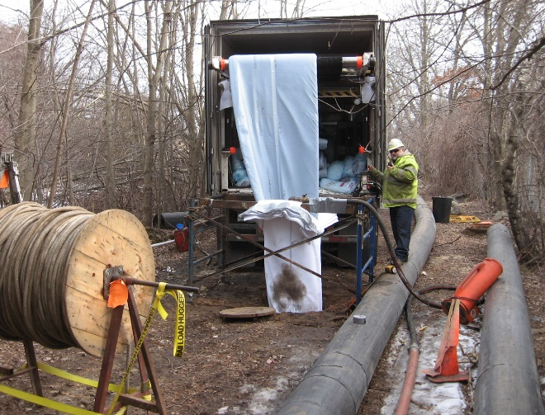
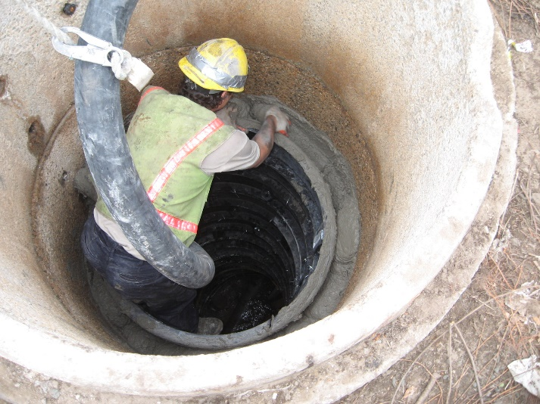
Cost-Effective?
CEA hasn’t yielded effective I/I removal in some cases
Migration of infiltration
Limited design life of fixes
Need to look at
Design life of fixes
Removal assumptions
(50 % peak infiltration)
Collecting post-construction data

Slide 21
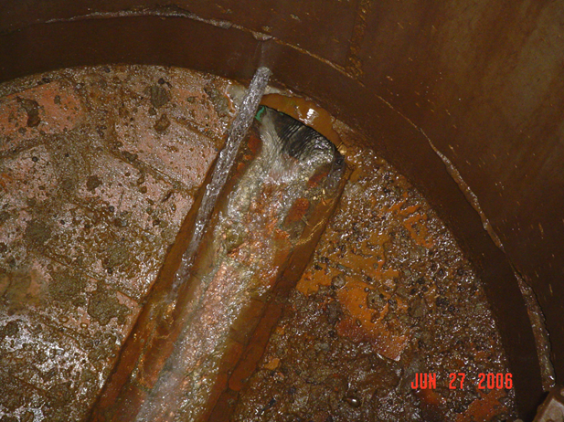
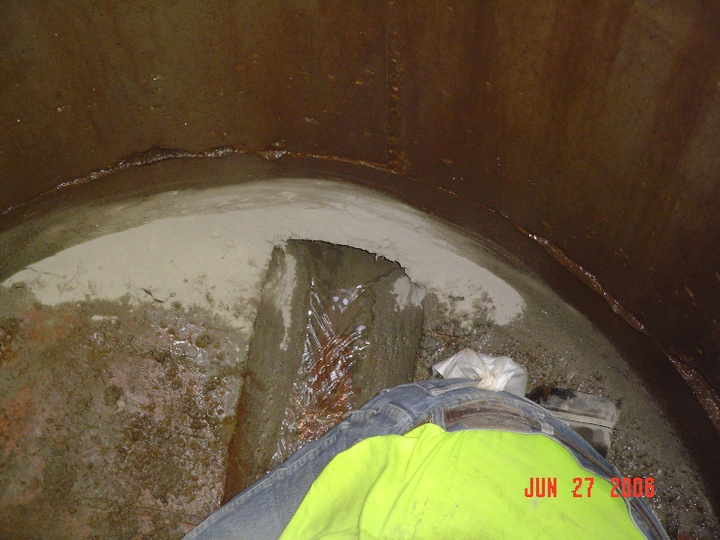
In-Field Adjustments

Slide 22
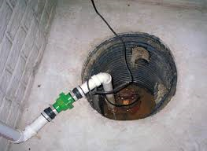
Private Inflow Removal
Sewer regulations must prohibit connection of inflow sources
Can have BIG impact, but often avoided:
Sump pumps
Roof leaders
drains
Requires property inspections

Slide 23
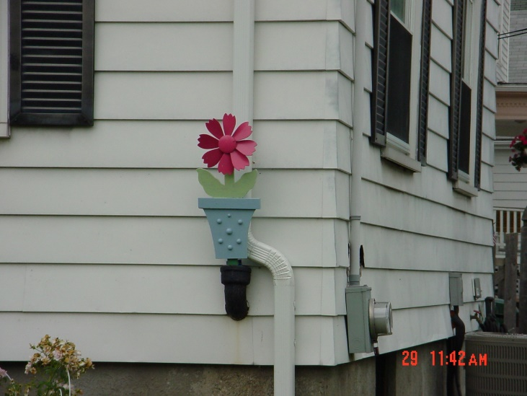
Private Inflow Removal Technically Infeasible or Cost-Prohibitive?
Factors:
Private inflow causing/contributing to SSOs?
Costs to utility/property owner for removal
Is there a reasonably feasible alternative
discharge location?
Creation of nuisance conditions
DEP: If frequent SSO’s, rigorous private inflow identification/removal will be required!

Slide 24
SSES Report
Report/Recommendations:
List of rehabilitation work
I/I estimated to be removed
Cost
Schedule for design and construction
Post Construction Monitoring
12, 18, 24 month warranties

Slide 25
Funding Sources
SRF Funds Are Available – 2% Loan Program
SRF funds studies and construction work
Competitive process
Massachusetts Water Resources Authority
Boston metro/area, 43 communities
I/I Community Support Program – 75% grants!
Ten phase of distributions so far, over the past 15 years

Slide 26
It Takes Two
Notes:
WSSC Trunk Sewer Inspections

Slide 27
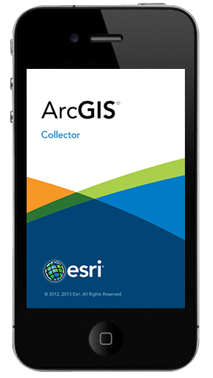
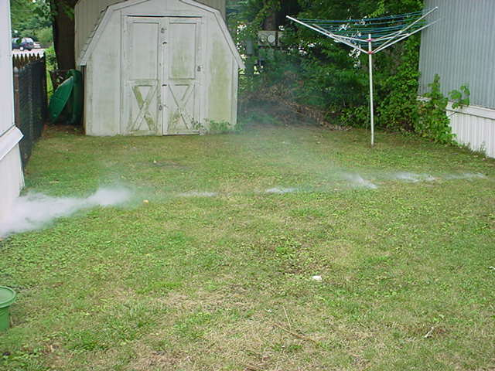
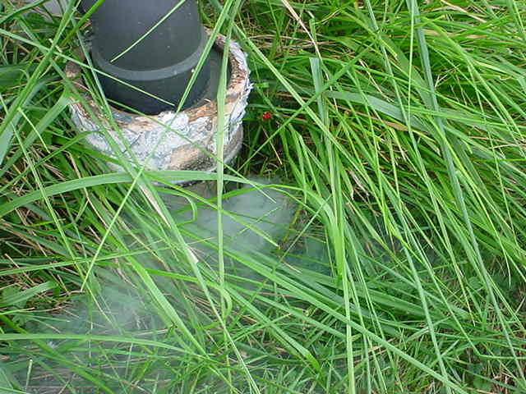
ArcGIS Collector
Notes:
Completely Customizable
Use it for any sewer field activities
manhole inspections
smoke testing
tracking CCTV inspections
Use built-in GPS or connect an external unit for greater accuracy
ESRI supported

Slide 28
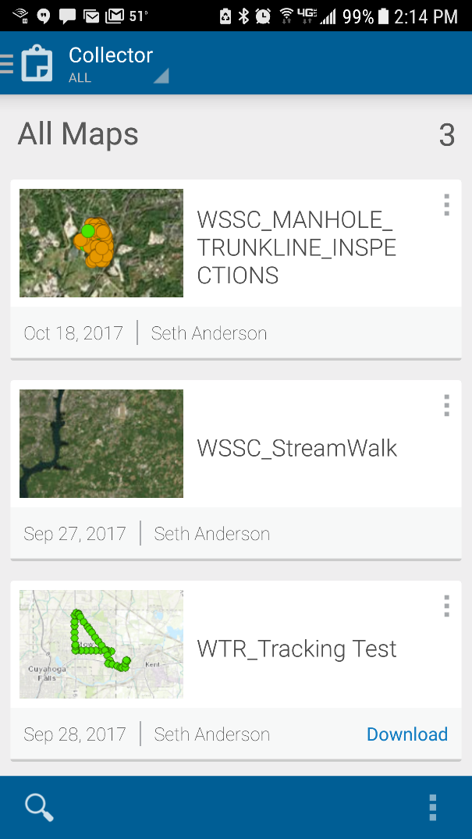
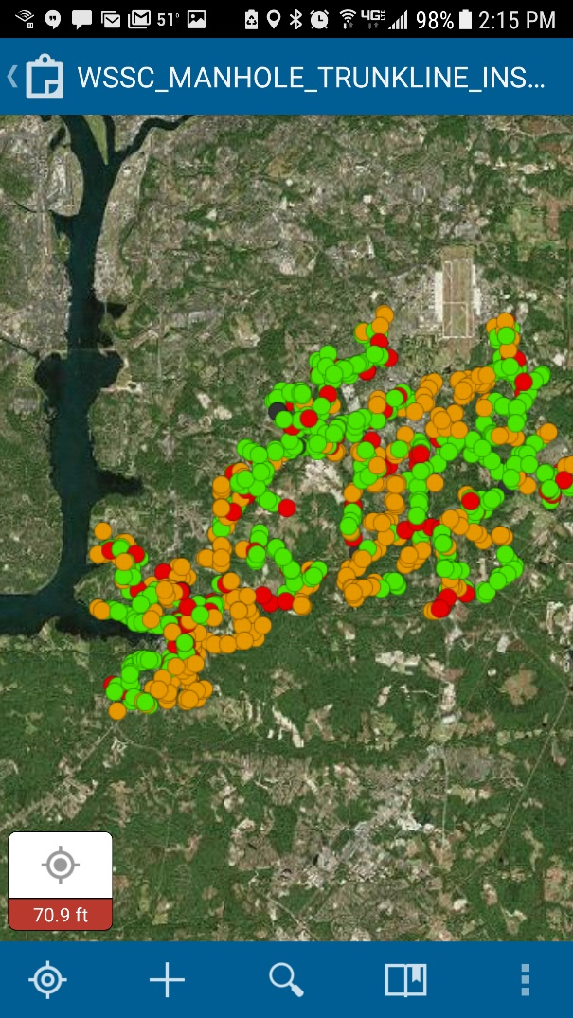
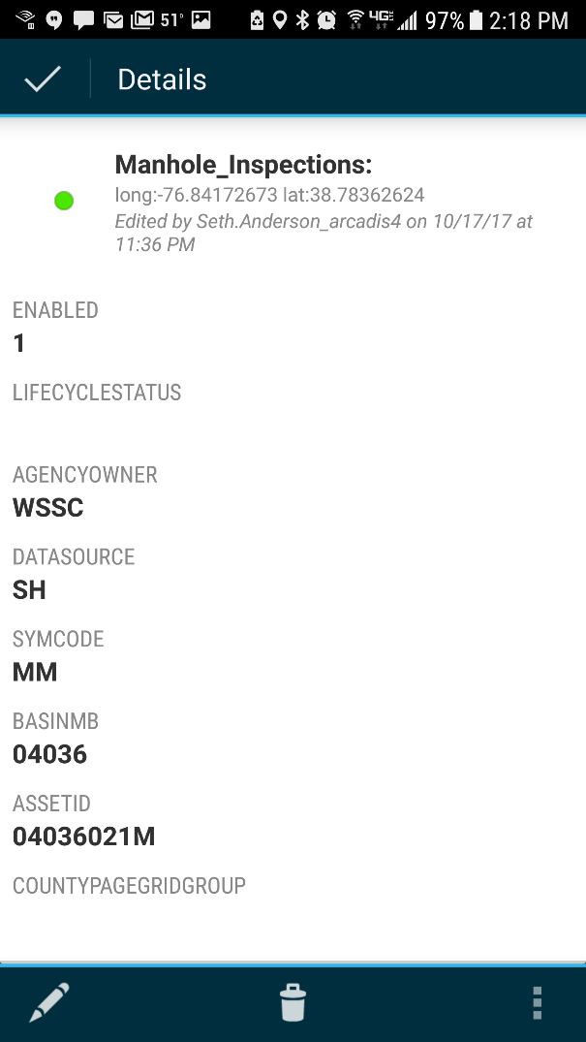
WSSC Trunk Sewer Manhole Inspections
Notes:
Real time tracking of completed inspections – great for multiple teams operating in the same area

Slide 29
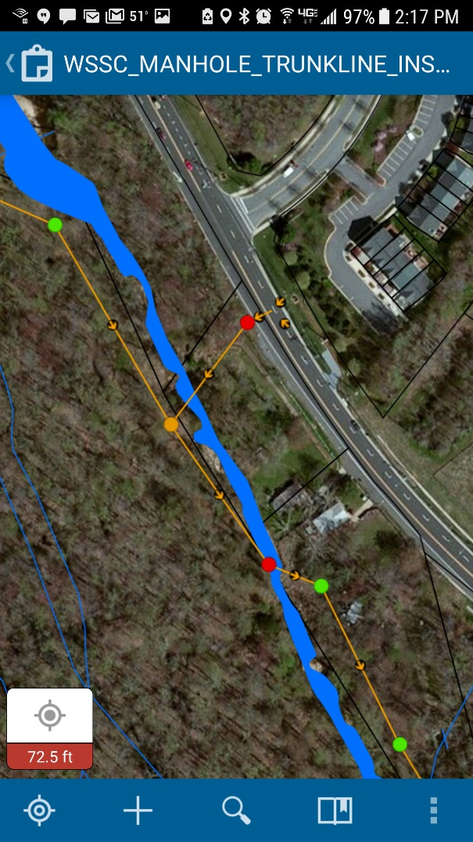
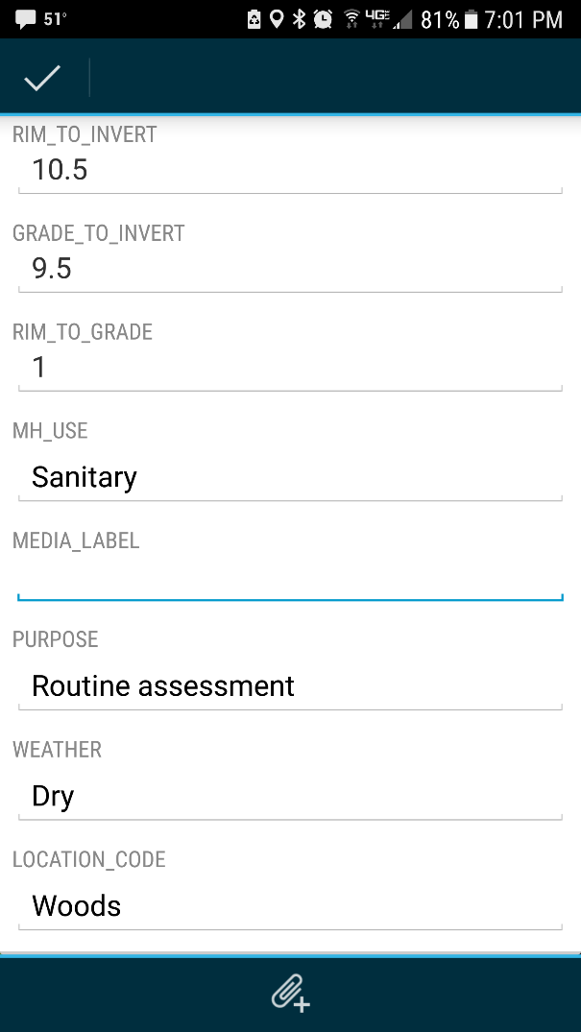
WSSC Trunk Sewer Manhole Inspections

Slide 30
WSSC Trunk Sewer Manhole Inspections
Notes:
Field teams:
Collect the data
Provide feedback on the tools (constant improvement)
Office Support:
Prep GIS Mapping
QA/QC Reviews and feedback to field teams
Prep Deliverables
Trade roles:
Have QA reviewers do a some inspections
Have inspectors do some QA reviews

Slide 31
ArcGIS Collector
Features/Benefits
ESRI Application
Integrated GPS
Cloud Data
Real-time Tracking
Multiple Users
Direct Data Entry
Link Photos and Videos
Notes:
ArcCollector - No hand notes, GPS locating for data entry - better accuracy, Less steps for error data entry/transfer, Mulitple users, Immediate entry to , Offline vs. online mode (cellular connection, battery life)
Daily data backup (or more) (manually if not online) - or constant backup by connection to remote server (cellular data plan)

Slide 32
ArcGIS Collector
Features/Benefits
Challenges
ESRI Application
Integrated GPS
Cloud Data
Real-time Tracking
Multiple Users
Direct Data Entry
Link Photos and Videos
Battery Life
Tree Cover
Cellular Coverage
Screen Brightness
Notes:
ArcCollector - No hand notes, GPS locating for data entry - better accuracy, Less steps for error data entry/transfer, Mulitple users, Immediate entry to , Offline vs. online mode (cellular connection, battery life)
Daily data backup (or more) (manually if not online) - or constant backup by connection to remote server (cellular data plan)

Slide 33
Questions?
Kevin Brander, PE
MassDEP/NERO
(978) 694-3236
Kevin.Brander@state.ma.us
Scott Haynes, PE, BCEE
Scott.Haynes@arcadis.com
Paul Batman, PE
Paul.Batman@arcadis.com

