Slide 1
Trained Inspectors for Trenchless Rehabilitation Projects
Lynn E. Osborn, P.E.
NASSCO Technical Director

Slide 2
Trenchless Rehabilitation
Multi-billion dollar industry
Solutions identified for almost any pipeline
Many factors contribute to this:
  Lower cost
  Minimum disruption
  Reduces sewage overflows
  Reduces water line leakage
Although this presentation discusses cured-in-place pipe (CIPP), the inspection principles presented are appropriate for any trenchless technology

Slide 3
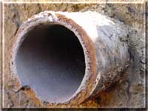
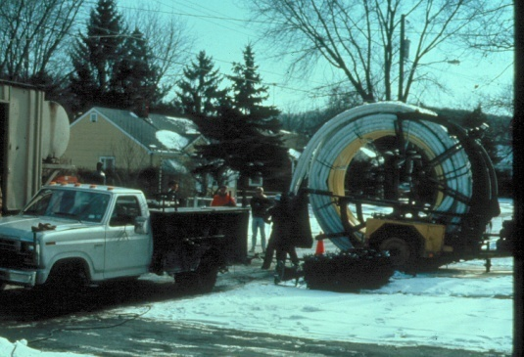
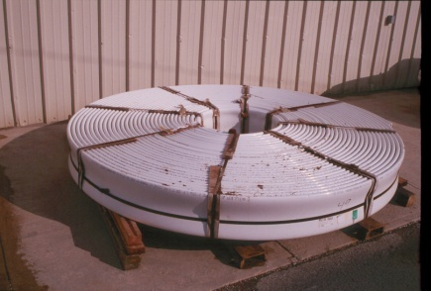
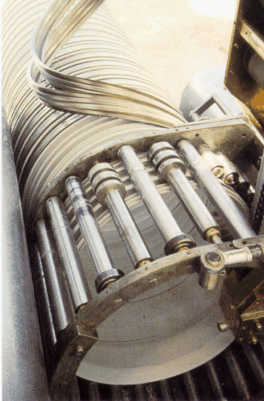
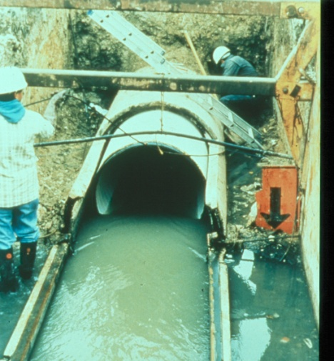
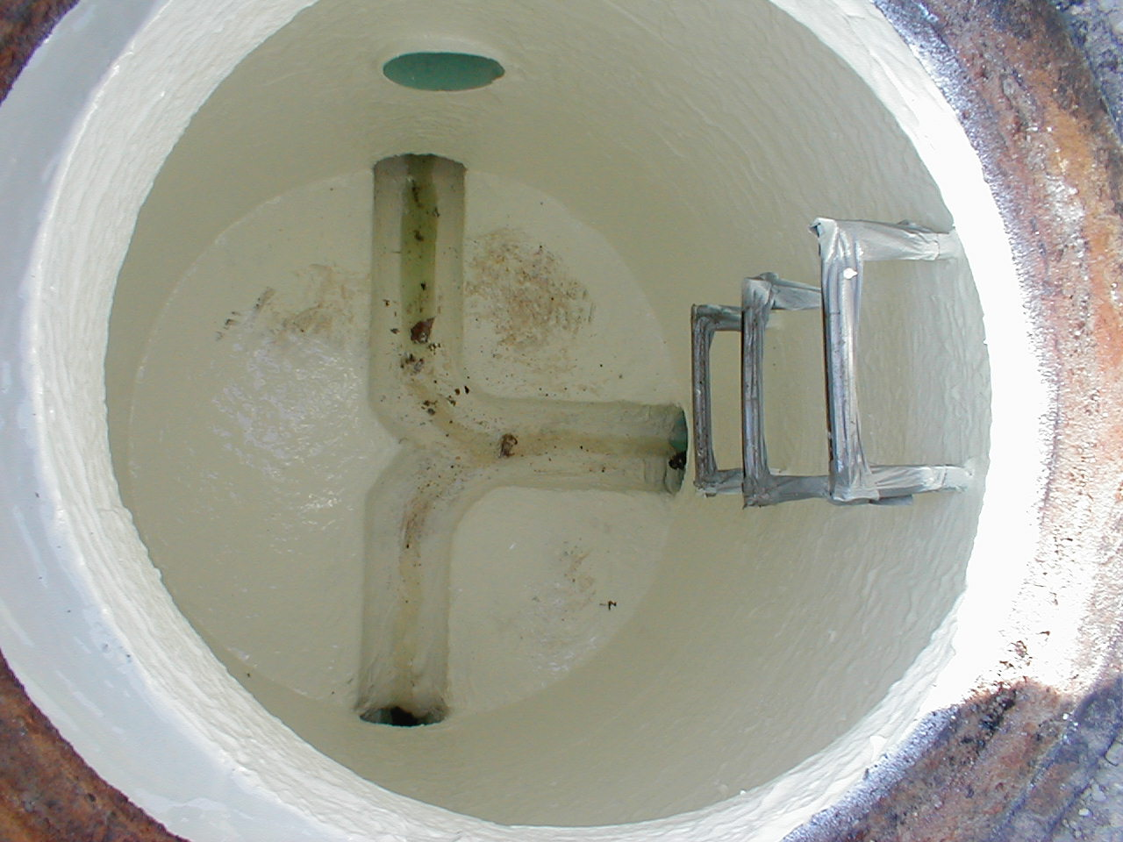
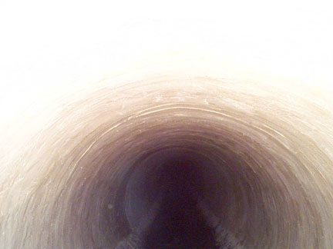
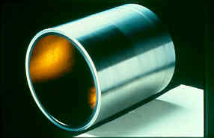
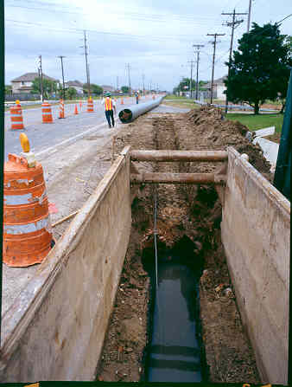
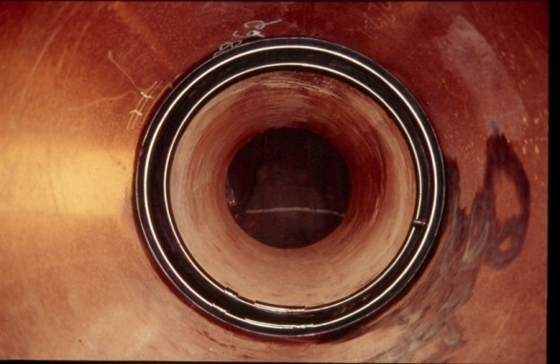
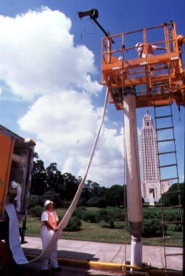
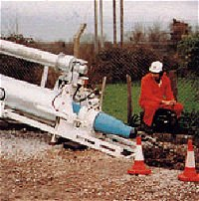
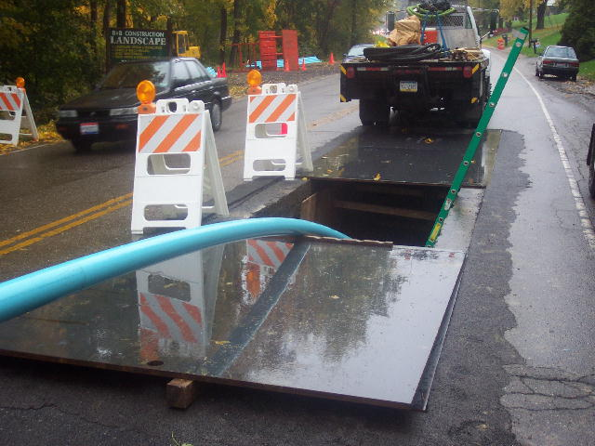
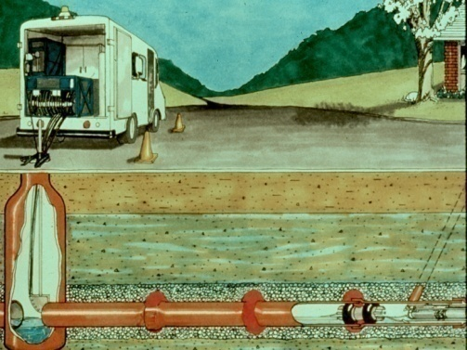
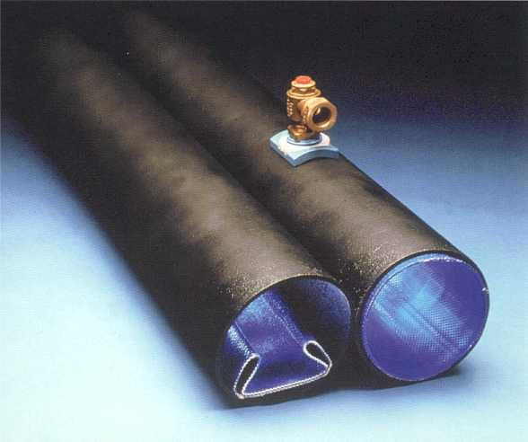
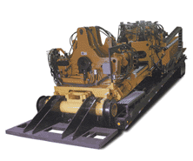
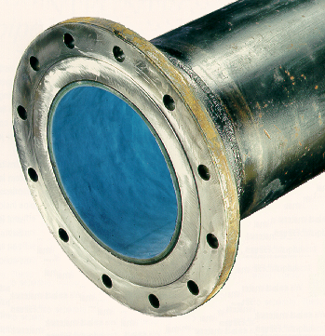
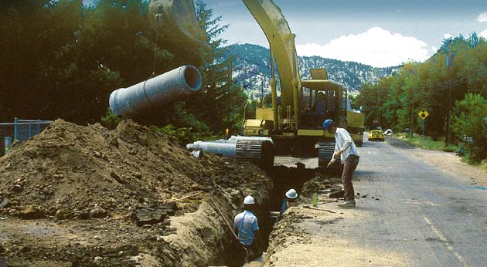
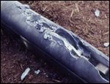
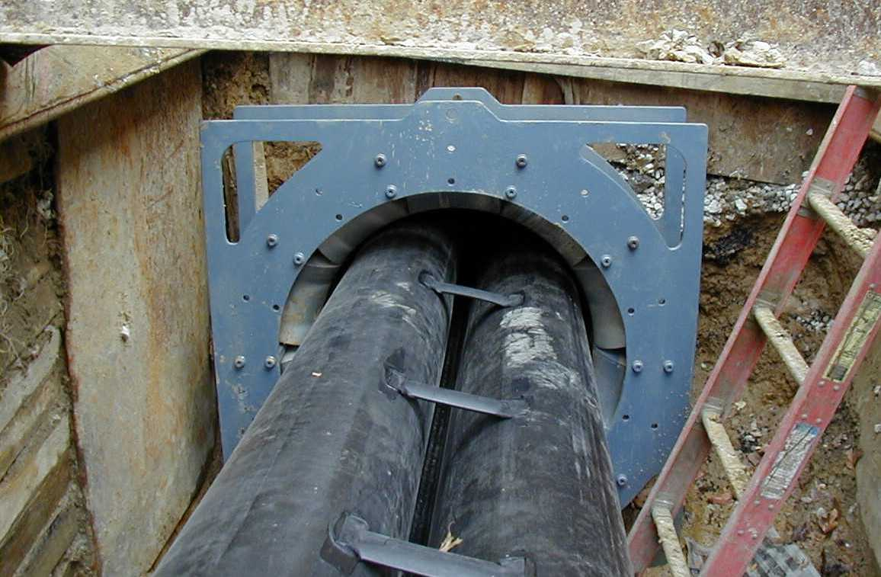

Slide 4
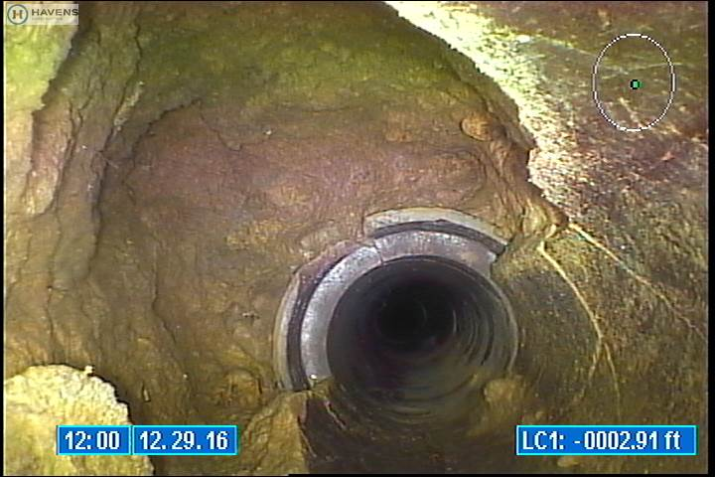
Background
Pipelines can deteriorate and fail when:
  Constructed from low quality materials
  Poor installation

Slide 5
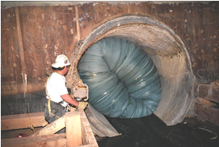
CIPp
Layers of felt and/or fibers are combined to create a tube with a specific thickness
The tube material is saturated with a liquid thermosetting resin
Cured to form a CIPP
CIPP is manufactured in a factory
and in the field

Slide 6
Trenchless rehabilitation projects rely on good engineering design principals, qualified installers and trained inspectors.

Slide 7
Public Works Construction
Traditional public works construction services typically include:
Survey, evaluation and design
Construction
Construction Management
Measurement and testing of key elements

Slide 8
Trenchless Construction
Inspection and measurement of quality during installation deemed unnecessary
Installations were completed with little oversight or inspection.
Lack of trained and certified inspectors
Quality requirements often not measured

Slide 9
Trenchless Project Quality
Quality varies from project to project.
Best quality at the lowest price requires performance based specifications containing quality controls, installation quality assurance and testing and inspection of key components
Performance based specifications focus more on the installed or delivered product quality instead of the means and methods to deliver the product

Slide 10
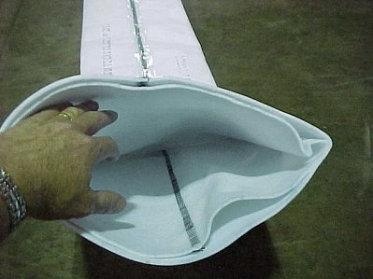
Quality Checks Before and During Installation
For CIPP, five key installation requirements to be measured before and during construction:
Tube & Resin Quality
  As specified in the contract
  Verifiable industry standard material
  Verified by the engineer/inspector

Slide 11
Resin Quantity
  Resin quantity very important- resin becomes the CIPP
  Verify resin quantity by reviewing the wet-out report
  Example resin saturation charts
    are available from the supplier

Slide 12
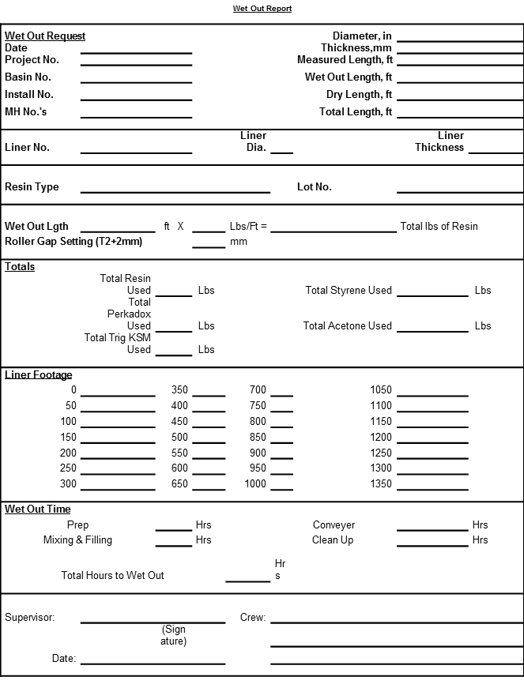
Example CIPP Wet-Out Report

Slide 13
Example Saturation Chart
(Pounds per Foot)
Thickness (mm)
Pipe Diameter, inches | 3.0 | 4.5 | 6.0 | 7.5 | 9.0 | 10.5 | 12.0 | 13.5 | 15.0 | 16.5 | 18.0 | 19.5
6.0 | 1.0 | 1.5
8.0 | 1.3 | 2.0 | 2.6 | 3.2 | 3.8
10.0 | 0.0 | 2.5 | 3.3 | 4.0 | 4.8
12.0 | 0.0 | 3.0 | 3.9 | 4.9 | 5.8
15.0 |  | 3.7 | 4.9 | 6.1 | 7.3
18.0 |  | 4.5 | 5.9 | 7.4 | 8.8 | 10.2
21.0 |  |  | 6.9 | 8.6 | 10.3 | 12.0 | 13.7
24.0 |  |  | 7.9 | 9.9 | 11.8 | 13.7 | 15.7 | 17.6
27.0 |  |  |  | 11.1 | 13.3 | 15.5 | 17.7 | 19.8 | 22.0
30.0 |  |  |  | 12.4 | 14.8 | 17.2 | 19.7 | 22.1 | 24.5
33.0 |  |  |  |  | 16.3 | 19.0 | 21.7 | 24.3 | 27.0 | 29.6
36.0 |  |  |  |  | 17.8 | 20.7 | 23.7 | 26.6 | 29.5 | 32.4 | 35.3
42.0 |  |  |  |  |  | 24.2 | 27.7 | 31.1 | 34.5 | 37.9 | 41.2 | 44.6
Pipe Diameter, inches | 12.0 | 13.5 | 15.0 | 16.5 | 18.0 | 19.5 | 21.0 | 22.5 | 24.0 | 25.5 | 27.0 | 28.5
48.0 | 31.6 | 35.6 | 39.5 | 43.4 | 47.2 | 51.1 | 55.0 | 58.8 | 62.7
54.0 |  | 40.1 | 44.5 | 48.8 | 53.2 | 57.6 | 62.0 | 66.3 | 70.7 | 75.0
60.0 |  |  | 49.5 | 54.3 | 59.2 | 64.1 | 69.0 | 73.8 | 78.7 | 83.5 | 88.3
66.0 |  |  |  | 59.8 | 65.2 | 70.6 | 75.9 | 81.3 | 86.6 | 92.0 | 97.3 | 102.6
72.0 |  |  |  |  | 71.2 | 77.1 | 82.9 | 88.8 | 94.6 | 100.5 | 106.3 | 112.1

Slide 14
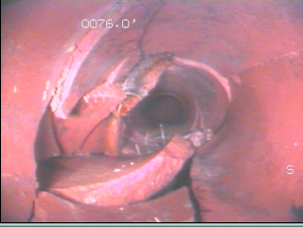
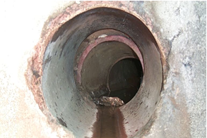
Installation
  Is the host pipe acceptable for installation based on ASTM or specified standards?
  Verified through pre-installation CCTV
  Is additional preparation and/or cleaning required?
  Are manufacturer’s installation guidelines followed?

Slide 15
Curing
Curing is a critical part of the installation process
  Based on manufacturer’s suggested requirements and contractor performance for different field conditions
  Monitor either from digital
    readers or from a computer
  Actual cure time can be compared
    to the recommended cure schedule

Slide 16
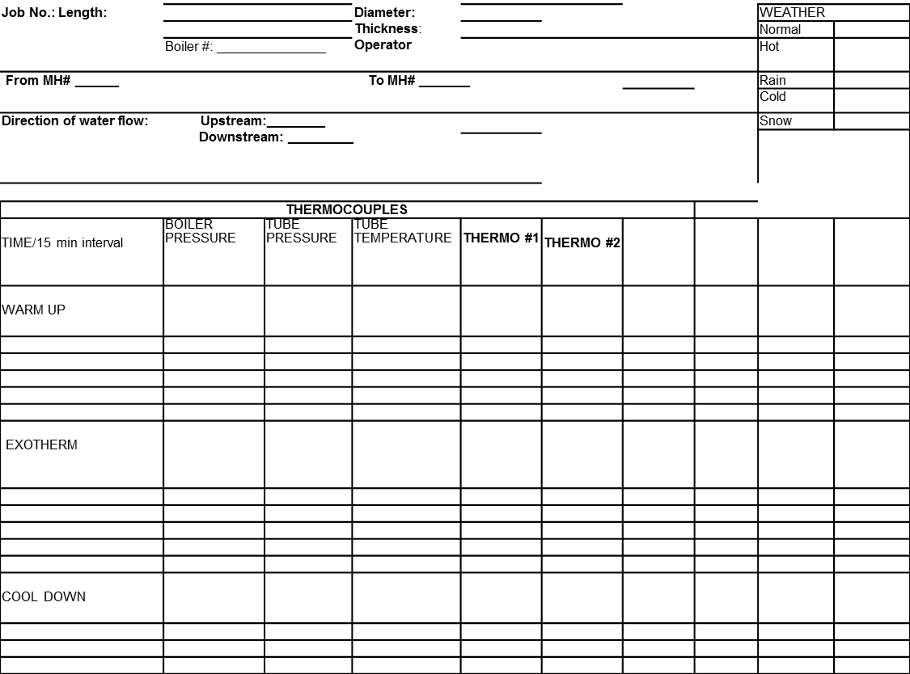
Sample Curing Log

Slide 17
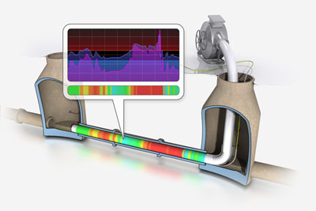
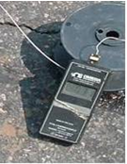
Cure Monitoring

Slide 18
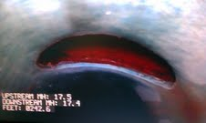
House Service Reconnections
  Trained and experienced operators
  Identify the location and open the connection without damaging the adjacent area
  Leave a clean, smooth opening meeting the specified requirements
The quality and quantity of robotic reconnections of house services to the public sewer should be verified by a trained inspector.

Slide 19
SERVICE CONNECTIONS
  Unacceptable Service Connection Reinstatement

Slide 20
Minimum Quality Assurance After Installation
Five key measurements:
Visual inspection to verify a defect free and functionally operating system (ASTM F1216, F1743 & F2019)
  NASSCO recommends a post-installation CCTV
  Worker entry on large diameter projects
Fin at 7:00 o’clock

Slide 21
Minimum Quality Assurance After Installation
Physical properties of the installed product as specified
Wall thickness meets or exceeds design value

Slide 22
Minimum Quality Assurance After Installation
Corrosion resistance
  Manufacturer’s certification for municipal projects
  May require corrosion testing for industrial projects
Leakage allowance within specified requirements

Slide 23
Trenchless Rehabilitation Inspection
Like other public works construction, inspection is required for trenchless rehabilitation installations
A trained and qualified inspector is key for ensuring a project is built to contract specifications and the customer’s expectations
Training for the inspection of trenchless rehabilitation projects has slowly become a reality
Many utility owners now realize that trenchless rehabilitation requires the same professional design, construction and inspection as is required with other traditional projects

Slide 24
Example of a Project With Inspection
Often includes performance specifications with QA/QC requirements
Lowest bid based on minimal assumptions by the contractor
All quality benchmarks are measured as specified
Project delivered with specified materials (quality & quantity)
Material installed to manufacturer’s recommendations
Warranty inspections scheduled and executed
Contractor completes repairs as required
Product and service life as specified in the contract

Slide 25
Result: Owner is satisfied and expectations are met

Slide 26
The quality of the installed product can be predicted from the measurable requirements in the contract and the actual measurement of those requirements by the inspector during installation.

Slide 27
Training Programs
NASSCO inspector training and certification programs:
Cured-In-Place Pipe
Manhole Rehabilitation
Grouting (under development)
These programs are designed from a field perspective with the inspector and engineer in mind.

Slide 28
Conclusions
For the owner to obtain the best quality product at the lowest price:
  Engineering design
  Experienced contractor
  Trained inspector

Slide 29
Questions ?

